Slide 1
Ullman et al. : Database System Principles
Notes 5: Hashing and More

Slide 2
Hashing
key → h(key)
<key>
Buckets
(typically 1
disk block)
.
.
.

Slide 3
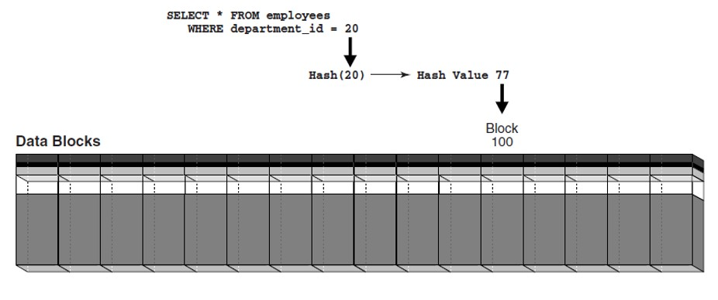
Hashing

Slide 4
Two alternatives
.
.
.
(1) key → h(key)
records
(direct reference, not flexible)
.
.
.

Slide 5
Two alternatives
record
(2) key → h(key)
key 1
(indirect reference, more flexible)
Index
Alt (2) for “secondary” search key

Slide 6
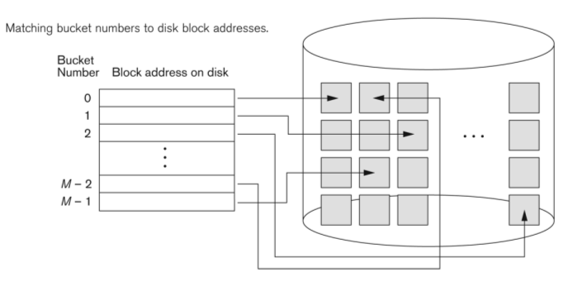
Typical implementation

Slide 7
Example hash function
Key = ‘x1 x2 … xn’ n byte character string
Have b buckets
h: add x1 + x2 + ….. xn
compute sum modulo b

Slide 8
☒ This may not be best function …
☒ Read Knuth Vol. 3 if you really need to select a good function.
Good hash  Expected number of
function: keys/bucket is the
same for all buckets

Slide 9
Within a bucket:
Do we keep keys sorted?
Yes, if CPU time critical
& Inserts/Deletes not too frequent

Slide 10
Next: example to illustrate inserts, overflows, deletes
h(K)

Slide 11
EXAMPLE 2 records/bucket
INSERT:
h(a) = 1
h(b) = 2
h(c) = 1
h(d) = 0
0
1
2
3

Slide 12
EXAMPLE 2 records/bucket
INSERT:
h(a) = 1
h(b) = 2
h(c) = 1
h(d) = 0
0
1
2
3
d
a
c
b
h(e) = 1

Slide 13
EXAMPLE 2 records/bucket
INSERT:
h(a) = 1
h(b) = 2
h(c) = 1
h(d) = 0
0
1
2
3
d
a
e
c
b
h(e) = 1

Slide 14
EXAMPLE: deletion
Delete: e f
0
1
2
3
a
b
d
c
e
f
g

Slide 15
EXAMPLE: deletion
Delete: e f
0
1
2
3
a
b
d
c
c
e
f
maybe move
“g” up
g

Slide 16
EXAMPLE: deletion
Delete: e f
0
1
2
3
a
b
d
c
d
c
e
f
maybe move
“g” up
g

Slide 17
Rule of thumb:
Try to keep space utilization
between 50% and 80%
Utilization = # keys used
total # keys that fit
If < 50%, wasting space
If > 80%, overflows significant depends on how good hash function is & on # keys/bucket

Slide 18
How do we cope with growth?
Overflows and reorganizations
Dynamic hashing

Slide 19
How do we cope with growth?
Overflows and reorganizations
Dynamic hashing
Extensible
Linear

Slide 20
Extensible hashing: two ideas
(a) Use i of b bits output by hash function
b
h(K) →
use i → grows over time….
00110101

Slide 21
h(K)[i ]: means the first i bits of the output by hash function
(b) Use directory
h(K)[i ] to bucket
.
.
.
.
.
.

Slide 22
Example: h(k) is 4 bits; 2 keys/bucket
1
i =
0
1
1
0001
1
1001
1100
Insert 1010

Slide 23
Example: h(k) is 4 bits; 2 keys/bucket
1
i =
0
1
1
0001
1
1001
1010
1100
1
Insert 1010
1100

Slide 24
Example: h(k) is 4 bits; 2 keys/bucket
i =
2
1
i =
00
01
10
11
1
0001
1
2
1001
1010
1100
2
New directory
1
Insert 1010
1100

Slide 25
Example continued
i =
2
00
01
10
11
1
0001
2
1001
1010
Insert:
0111
0000
2
1100

Slide 26
Example continued
0000
i =
2
0001
00
01
10
11
1
0001
0111
0111
2
1001
1010
Insert:
0111
0000
2
1100

Slide 27
Example continued
2
0000
i =
2
0001
00
01
10
11
1
2
0001
0111
0111
2
1001
1010
Insert:
0111
0000
2
1100

Slide 28
Example continued
0000
2
i =
2
0001
00
01
10
11
0111
2
1001
2
1010
Insert:
1001
1100
2

Slide 29
Example continued
0000
2
i =
2
0001
00
01
10
11
0111
2
1001
1001
1010
1001
2
1010
Insert:
1001
1100
2

Slide 30
Example continued
i =
3
0000
2
000
001
010
011
100
101
110
111
i =
2
0001
00
01
10
11
0111
2
1001
3
1001
1010
1001
2
3
1010
Insert:
1001
1100
2

Slide 31
Extensible hashing: deletion
No merging of blocks
Merge blocks and cut directory if possible
(Reverse insert procedure)

Slide 32
Deletion example:
Run thru insert example in reverse!
But: Typically not implemented

Slide 33
Note: Still need overflow chains
Example: many records with duplicate keys
insert 1100
if we split:
2
1
1101
1100
2
1100
1100

Slide 34
Solution: overflow chains
insert 1100
add overflow block:
1
1
1101
1101
1100
1100
1101

Slide 35
Extensible hashing
Summary
Can handle growing files
- with less wasted space
- with no full reorganizations
+
Indirection
(Not bad if directory in memory)
Directory doubles in size
(Now it fits, now it does not)
-
-

Slide 36
Linear hashing
Another dynamic hashing scheme
Two ideas:
(a) Use i low order bits of hash
b
01110101
grows
i
(b) File grows linearly

Slide 37
Example b=4 bits, i =2, 2 keys/bucket
Future
growth
buckets
0000
0101
1010
1111
00 01 10 11
m = 01 (max used block)
Rule
If h(k)[i ] ≤ m, then
look at bucket h(k)[i]
else, look at bucket h(k)[i] - 2^{i -1}

Slide 38
Example b=4 bits, i =2, 2 keys/bucket
insert 0101
Future
growth
buckets
0000
0101
1010
1111
00 01 10 11
m = 01 (max used block)
Rule
If h(k)[i ] ≤ m, then
look at bucket h(k)[i ]
else, look at bucket h(k)[i ] - 2^{i -1}

Slide 39
Example b=4 bits, i =2, 2 keys/bucket
insert 0101
0101
can have overflow chains!
Future
growth
buckets
0000
0101
1010
1111
00 01 10 11
m = 01 (max used block)
Rule
If h(k)[i ] ≤ m, then
look at bucket h(k)[i ]
else, look at bucket h(k)[i ] - 2^{i -1}

Slide 40
Note
In textbook, n is used instead of m
n=m+1 (n=number of used blocks)
n=10 (n=2 in decimal)
Future
growth
buckets
0000
0101
1010
1111
00 01 10 11
m = 01 (max used block)

Slide 41
Example b=4 bits, i =2, 2 keys/bucket
0101
insert 0101
Future
growth
buckets
0000
0101
1010
1010
1111
00 01 10 11
m = 01 (max used block)
10

Slide 42
Example b=4 bits, i =2, 2 keys/bucket
0101
insert 0101
Future
growth
buckets
0000
0101
1010
1010
1111
00 01 10 11
m = 01 (max used block)
10
11

Slide 43
Example b=4 bits, i =2, 2 keys/bucket
0101
insert 0101
Future
growth
buckets
0000
0101
1010
1111
1010
0101
1111
00 01 10 11
m = 01 (max used block)
10
11

Slide 44
Example Continued: How to grow beyond this?
i = 2
0000
0101
1010
1111
0101
00 01 10 11
. . .
m = 11 (max used block)

Slide 45
Example Continued: How to grow beyond this?
i = 2
3
0000
0101
1010
1111
0101
0
00 01 10 11
0
0
0
. . .
100 101 110 111
m = 11 (max used block)

Slide 46
Example Continued: How to grow beyond this?
i = 2
3
0000
0101
1010
1111
0101
0
00 01 10 11
100
0
0
0
. . .
100 101 110 111
m = 11 (max used block)
100

Slide 47
Example Continued: How to grow beyond this?
i = 2
3
0000
0101
1010
1111
0101
0101
0101
0
00 01 10 11
100
101
0
0
0
. . .
100 101 110 111
m = 11 (max used block)
100
101

Slide 48
 When do we expand file?
Keep track of: # used slots
total # of slots
= U
#used slots → #records, total # of slots → #buckets
If U > threshold then increase m
(and maybe i )

Slide 49
Linear Hashing
Summary
Can handle growing files
- with less wasted space
- with no full reorganizations
No indirection like extensible hashing
+
+
Can still have overflow chains
-

Slide 50
Example: BAD CASE
Very full
Very empty Need to move
m here…
Would waste
space...
Hashing depends on data distribution!

Slide 51
Summary
Hashing
- How it works
- Dynamic hashing
- Extensible
- Linear

Slide 52
Next:
Indexing vs Hashing
Index definition in SQL
Multiple key access

Slide 53
Indexing vs Hashing
Hashing good for probes given key
e.g., SELECT …
FROM R
WHERE R.A = 5

Slide 54
Indexing vs Hashing
INDEXING (Including B Trees) good for
Range Searches:
e.g.,
SELECT FROM R
WHERE R.A > 5 AND R.A < 10;

Slide 55
Index definition in SQL
Create index name on rel (attr)
Create unique index name on rel (attr)
defines candidate key
Drop INDEX name

Slide 56
CANNOT SPECIFY TYPE OF INDEX
(e.g. B-tree, Hashing, …)
OR PARAMETERS
(e.g. Load Factor, Size of Hash,...)
... at least in SQL...
In Oracle you can !
Note

Slide 57
ATTRIBUTE LIST ⇒ MULTIKEY INDEX
(next)
e.g., CREATE INDEX foo ON R(A,B,C)
Note

Slide 58
Multi-key Index
Motivation: Find records where
DEPT = “Toy” AND SAL > 50k
What kind of indexes can support this query?

Slide 59
Strategy I:
Use one index, say Dept.
Get all Dept = “Toy” records and check their salary
I1

Slide 60
Strategy II:
Use 2 Indexes; Manipulate Pointers
Toy Sal > 50k
AND → intersection of pointers
p
p
p
p
p
p
p
p
p
p
p

Slide 61
Strategy III:
Multiple Key Index
One idea:
I2
I1
I3

Slide 62
Example
10k
15k
Example
Record
Dept
Index
Salary
Index
Art
17k
Sales
21k
Toy
Name=Joe
DEPT=Sales
SAL=15k
12k
15k
15k
19k

Slide 63
For which queries is this index good?
Find RECs Dept = “Sales” SAL=20k
Find RECs Dept = “Sales” SAL > 20k
Find RECs Dept = “Sales”
Find RECs SAL = 20k

